Slide 1



Predicting Sleep Disorders
Sleep disorders can significantly impact physical and mental well-being, affecting daily life and long-term health. This project focuses on developing a machine learning model to predict sleep disorders (None, Insomnia, Sleep Apnea) based on individual attributes such as age, gender, BMI, occupation, lifestyle habits (stress levels, physical activity), cardiovascular health indicators, and sleep patterns (sleep duration and quality). The goal is to enable early detection, personalized care, and better management of sleep-related health risks.
by Dinal Pandya
DP
Notes:
1

Slide 2
Introduction:
OBJECTIVE
IMPORTENCE
The objective of this project is to develop an accurate sleep disorder prediction model based on individual attributes such as age, gender, BMI, lifestyle habits, cardiovascular health indicators, and sleep patterns. This predictive approach aims to enable early detection of sleep disorders, support healthcare professionals in decision-making, and assist in designing personalized care strategies to improve sleep quality and overall well-being.
The importance of a sleep disorder prediction project lies in its ability to enable early diagnosis, improve sleep health, and support proactive healthcare strategies. By identifying individuals at risk of sleep disorders, it helps healthcare professionals implement preventive measures, personalize treatment plans, and promote better sleep hygiene, ultimately enhancing overall well-being and quality of life.
Notes:
2

Slide 3


1
Data Collection
Gathering and organizing data to train machine learning models.
2
Exploratory Data Analysis
Analyzing and visualizing data patterns to understand its characteristics.
3
Preprocessing
Preparing and cleaning data to enhance its quality and suitability.
4
Split Train & Test Data
Dividing the dataset into training and testing sets to evaluate.
5
Model Selection & Model Training
Choosing a suitable machine learning algorithm and optimizing its parameters.
6
Model Evaluation
Assessing the performance of machine learning model using metrics.
Conclusion
7
In conclusion, evaluating the performance of machine learning models using various metrics ensures accurate and reliable predictions.
Notes:
3

Slide 4
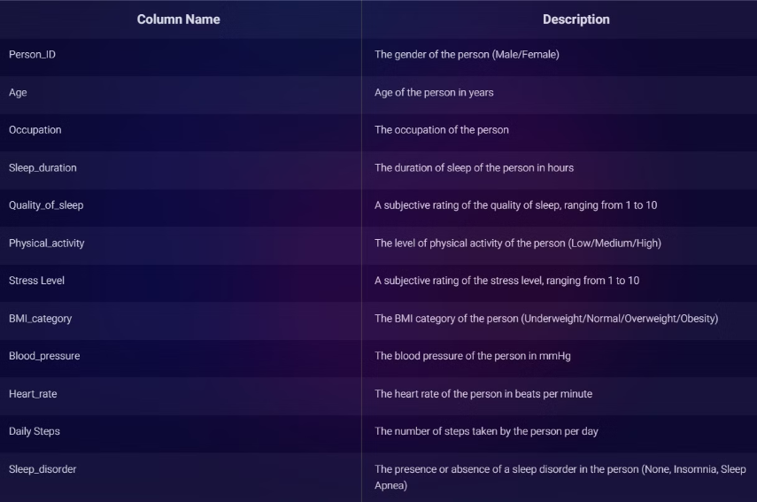
1.DATA COLLECTION
The dataset for this project was collected from individuals through health surveys and medical records, containing 374 rows and 12 columns. It includes demographic information such as Age, Gender, and Occupation, along with lifestyle habits like Stress Level, Physical Activity, and Smoking Status. Additionally, health indicators such as BMI Category, Heart Rate, and Blood Pressure are included, along with sleep-related attributes like Sleep Duration, Sleep Quality, and the target column Sleep Disorder. This comprehensive dataset serves as the foundation for building the sleep disorder prediction model.
Notes:
4

Slide 5

2.Exploratory Data Analysis (EDA)
EDA was conducted to understand the dataset's structure, distribution, and relationships between features. It involved analyzing demographic, lifestyle, and health-related attributes through statistical summaries and visualizations. Insights were gained into sleep patterns, stress levels, and their impact on sleep disorders, helping identify key features for model development.
Notes:
5

Slide 6
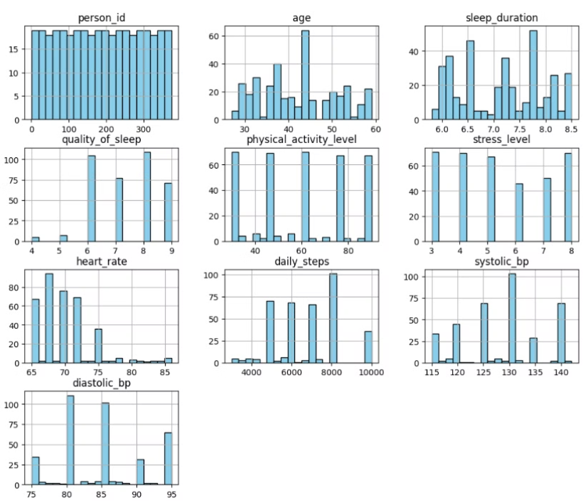
Histogram Of Numeric Feature:
person_id: Unique identifier for individuals (not relevant for model building).
age: Distribution of participants' ages, showing the majority fall between 30-50 years.
sleep_duration: Most individuals have sleep durations between
6-8 hours.
stress_level: Varies across individuals, with more participants having moderate to high stress levels.
quality_of_sleep: Most participants reported sleep quality between 6 and 9.
physical_activity_level: Displays varying levels of physical activity across participants.
heart_rate: Majority have heart rates between 65-75 bpm.
daily_steps: Shows how active participants are, with most taking between 4000-10000 steps daily.
systolic_bp: Blood pressure values range between 115-140 mmHg.
diastolic_bp: Blood pressure values range between 75-95 mmHg.
Notes:
6

Slide 7
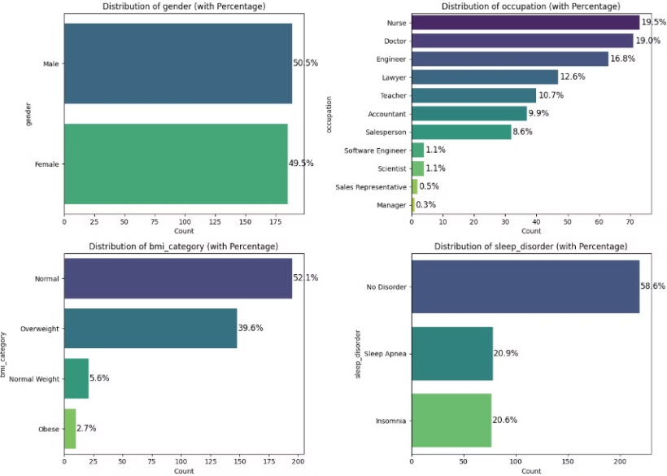
Categorical Feature Distributions:
Gender Distribution: The dataset is balanced in gender, with 50.5% males and 49.5% females.
Occupation Distribution: Most participants are Nurses (19.5%) and Doctors (19%), while Managers have the lowest representation (0.3%).
BMI Category Distribution: The majority fall under the Normal (52.1%) and Overweight (39.6%) categories, with few participants being obese.
Sleep Disorder Distribution: Around 58.6% have no sleep disorder, while the rest suffer from Sleep Apnea (20.9%) and Insomnia (20.6%).
Notes:
7

Slide 8

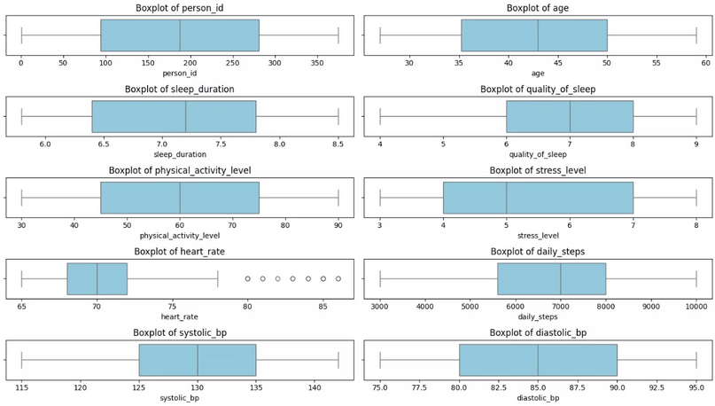
Box Plot for Numeric Feature :
Person ID: The data is evenly distributed without outliers, indicating unique identifiers.
Age: The age distribution is spread between 25 and 55, with no visible outliers.
Sleep Duration: Sleep duration varies between 6 to 8.5 hours, showing a balanced distribution.
Quality of Sleep: The majority of values range between 5 and 8, indicating moderate sleep quality.
Physical Activity Level: The data is right-skewed, ranging between 30 and 90, with no extreme outliers.
Stress Level: Stress levels vary between 3 and 8, showing a relatively normal
distribution.
Heart Rate: A few outliers above 80 indicate some individuals have an unusually high heart rate.
Daily Steps: The step count ranges from 3000 to 10,000, with no significant
outliers.
Systolic Blood Pressure (BP): BP values range from 115 to 140, showing
a normal spread.
Diastolic Blood Pressure (BP): The data is well-distributed between 75 and 95, with no major outliers.
Notes:
8

Slide 9
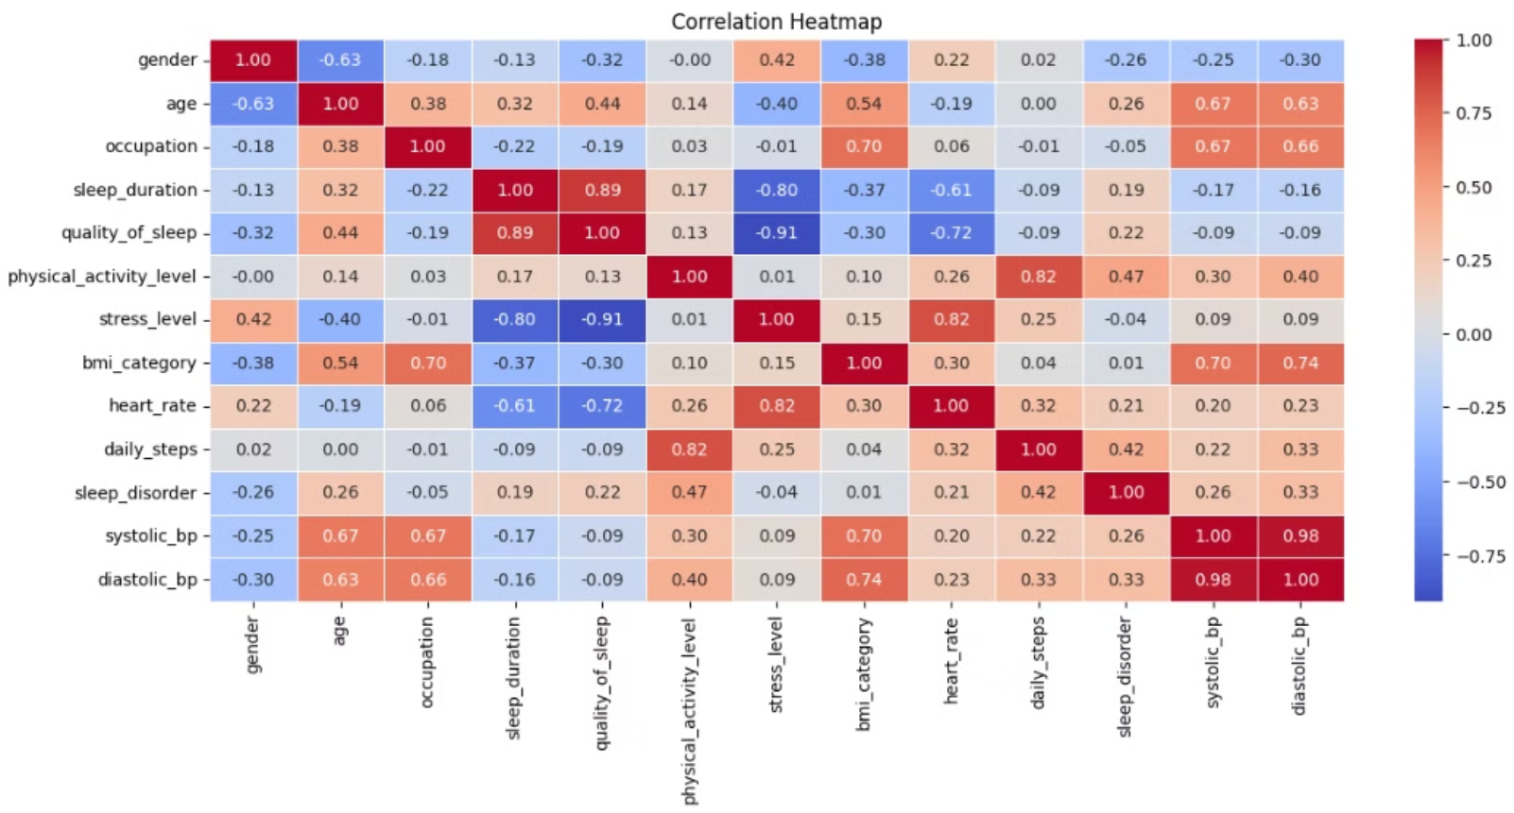
CORRELATION HEATMAP:
Notes:
9

Slide 10
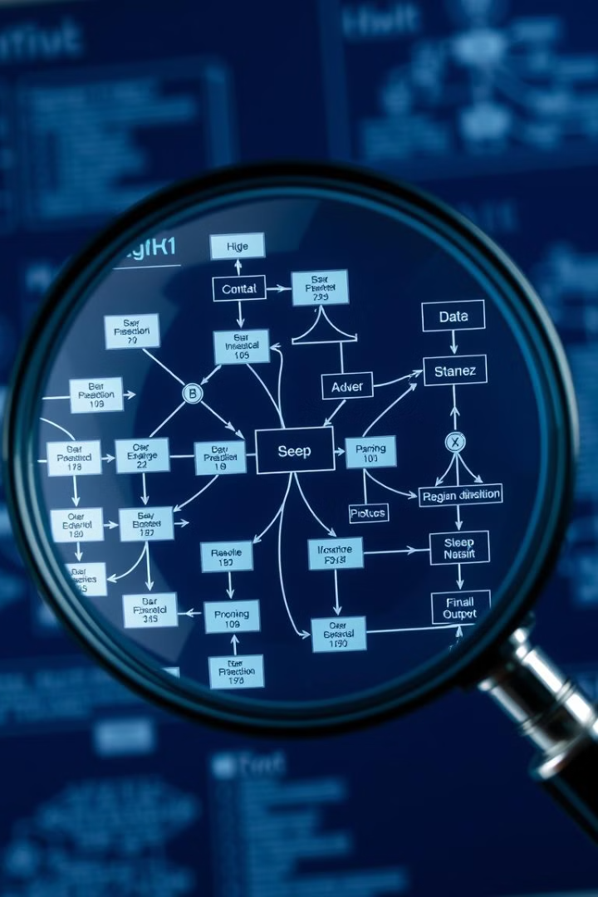
3.Data Preprocessing
Preparing the data for analysis involves cleaning, transforming, and formatting the raw data. This step is crucial for ensuring data quality and improving the accuracy of our model.
1
Irrelevant Feature Removal
Removed columns that did not contribute meaningful information: 'Id', 'diastolic_bp' &'quality_of_sleep'.
2
Handling Missing Values
There is no missing values are in the dataset but the target column has the type name like 'NaN' so the function is shows this as a missing values so i changed the name of 'NaN' to 'No Disorder'.
3
Categorical Feature Encoding
Label Encoding applied for compatibility with machine learning models.
4
Outlier Detection and Treatment
Outlier detection conducted using IQR and Z-score methods. No significant outliers found.
5
Feature Scaling
Standard Scaling applied to numerical features (mean=0, standard deviation=1).
Notes:
10

Slide 11
4.Train/Test Split
Testing Set
Training Set
The testing set is used to assess the model's ability to generalize to new data, providing a measure of its accuracy and predictive power.
Data Partition
The training set is used to train the machine learning model, enabling it to learn patterns and relationships from the data.
Splitting the dataset into training and testing sets allows us to evaluate model performance on unseen data.
Notes:
11

Slide 12




5.Model Selection: Choosing the Right Algorithm
Decision Tree
Random Forest
Support Vector Machine (SVM)
K-Nearest Neighbors (KNN)
Easy to understand, handles categorical features, but prone to overfitting.
Ensemble learning, reduces overfitting, good for complex datasets.
Effective for classification, finds optimal separating hyperplane, but sensitive to feature scaling.
Simple, non-parametric, but computationally expensive for large datasets.
Notes:
12

Slide 13
Why Not These Models?
Logistic Regression
1
Well-suited for binary classification, provides probabilities.
2
Neural Networks
Excellent for complex patterns and high accuracy.
Naive Bayes
3
Offers simplicity and speed for high-dimensional data.
4
Gradient Boosting
Combines weak learners for strong prediction.
Linear Discriminant Analysis (LDA)
5
Suitable for dimensionality reduction and classification.
6
AdaBoost
Combines multiple weak learners into a strong classifier.
Notes:
13

Slide 14
6.Model Performance Summary
Accuracy: the proportion of correct predictions among the total number of cases examined.
Precision: the proportion of true positive results (correctly predicted positives) out of all positive results (whether correct or incorrect).
Recall: the proportion of actual positives that are correctly identified.
F1 Score: the harmonic mean of precision and recall, providing a balanced measure of the model's accuracy.
Model Name
Accuracy
Precision
Recall
F1 Score
Decision Tree
0.91
0.91
0.89
0.90
Random Forest
0.94
0.94
0.93
0.94
Support Vector Machine
0.94
0.93
0.94
0.92
K-Nearest Neighbors
0.93
0.93
0.92
0.92
Notes:
14

Slide 15



7.Conclusion:
Key Factors
High Accuracy
Sleep disorder risk is influenced by factors such as age, stress levels, lifestyle habits (e.g., screen time, physical activity), mental health conditions, medical history, and sleep duration. These factors play a crucial role in determining sleep quality and overall well-being.
The best model is Random Forest Classifier as it has the highest Precision (0.94), Recall (0.93), F1-score (0.94), and Accuracy (0.94), making it the most balanced and reliable choice. It effectively minimizes false positives and false negatives, ensuring strong overall performance. SVM is a close second with slightly lower F1-score (0.92) but can be a good alternative if a lighter model is needed. 🚀
Future research
For future research, incorporating deep learning models, wearable sleep tracking data, genetic predisposition factors, and real-time physiological monitoring could enhance prediction accuracy. Additionally, developing personalized sleep improvement plans based on risk factors can aid in early intervention and overall well-being.
2
1
3
Notes:
15

Slide 16

Thank You!
Thank you for your attention. Predicting sleep disorders is essential for improving overall health and well-being. Early detection enables timely intervention, leading to better sleep management and quality of life.
Our machine learning models offer strong accuracy, identifying individuals at risk of sleep disorders. Proactive healthcare measures can help mitigate long-term health complications.
We hope this research contributes to better sleep health and enhances preventive care strategies.
Notes:
16

